Slide 1
Film Industry
Employment opportunities and Job roles

Slide 2
The film industry or motion picture industry comprises the technological and commercial bodies of filmmaking, i.e., film production companies, film studios, cinematography, film production, screenwriting, pre-production, post production, film festivals, distribution; and actors, film directors and other film crew employees.
So why work in film?
Well, there are many roles in a large industry, all of which help create masterpieces that are loved around the world. To be a part of a creation such as film, to impart your knowledge and creativity to help evolve something that just started as an idea, to a story. To something that the audience can relate to, feel for, want to be part of, love to hate and hate to love. Watched over and over again, treasured for lifetimes to come.

Slide 3
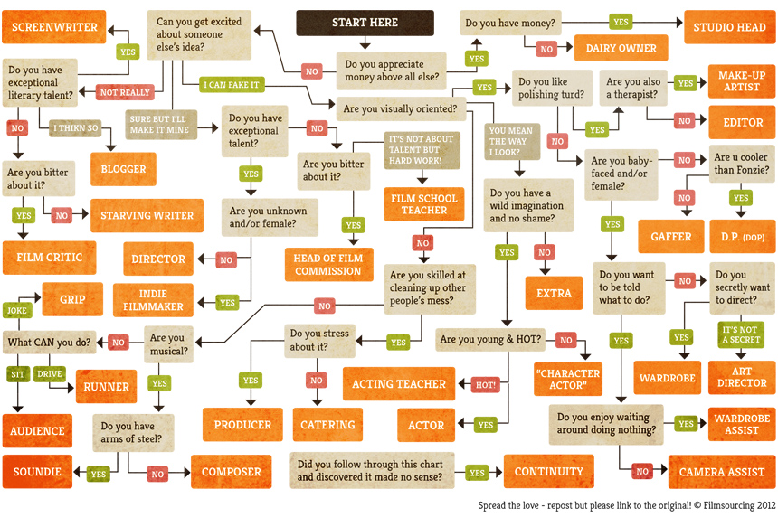

Slide 4
Director
What the job role is:
The director is the creative driving force in a films production, and acts as the crucial link between the production, technical for creative teams. Directors are responsible for creatively translating the films written script into actual images and sounds on the screen – they must visualize and define the style and structure of the film, then act as both a storyteller and team leader to bring this this vision to reality. A directors main duties include casting, script editing, shot composition, shot selection, and editing. Directors are ultimately responsible for a films artistic and commercial success or failure.

Slide 5
Personal skills:
Great creative vision
Dedication
Commitment
Artistic
Passion for film making
Strong and confident leader
Be able to make decisions
Good communication and interpersonal skills
Inspire and motivate
Attention to detail
Well under pressure
Determination
Make decisions
Delegate and collaborate with others
Inspire and motivate the team
Work intensively for long hours
Keep calm and think clearly under pressure
Have self-belief

Slide 6
Qualifications
You don’t need a formal qualification to become a Director.
There are numerous training courses and reference books on directing and studying the art and craft of directing is important.
However, the role can only really be mastered through in-depth practical experience. You will find writing a screenplay, directing your own short film or an amateur play are all good starting places.
You will also need extensive industry experience; up-to-date knowledge of filmmaking techniques and equipment is vital, as is learning how to work with actors to create a performance.

Slide 7
Professional skills
Extensive understanding of the film making process (technical and creative).
Up-to-date knowledge of film making techniques and equipment.
How to work with actors

Slide 8
Daily job requirements/responsibilities
Directors may write the films script or commission it to be written; or they maybe hired after an early draft of the script is complete. Directors must then develop a vision for the finished film, and define a practical route for achieving it. During pre-production, directors make crucial decisions such as selecting the right cast, crew and locations for the film. They then direct rehearsals, and the performances of the actors once the film is in production. Directors also manage the technical aspects of filming, including the camera, sound, lighting, design and special effects.
During post production, directors work closely with editors through the many technical processes of editing, to reach the final cut or version of the film. At all stages, directors are responsible for motivating the team to produce the best possible results. Directors must also appreciate the needs and expectations of the films financiers.

Slide 9
What is it about the job that interests me?
I have always loved movies, how they can make people feel so much. Movie-making is a form of art that talented artists use to make a creative difference in the world. They help people get away from the troubles of the real world, into a variety of different fantasies. To be able to be the prime creator of such an amazing aspect of this world, to be able to inflict these powerful emotions, to make people fall in love and hate characters. To make people laugh, scared, cry, have them on the edge of their seats. To be able to express your imagination and creativity, making something I love part of everyday life.

Slide 10
Producer
What the job role is:
Film producers fill a variety of roles depending upon the type of producer. Either employed by a production company or independent, producers plan and coordinate various aspects of film production, such as selecting script, coordinating writing, directing and editing, and arranging financing.

Slide 11
Personal skills:
Great creative vision
Dedication
Commitment
Artistic
Passion for film making
Strong and confident leader
Be able to make decisions
Good communication and interpersonal skills
Inspire and motivate
Attention to detail
Well under pressure
Determination
Make decisions
Delegate and collaborate with others
Inspire and motivate the team
Work intensively for long hours
Keep calm and think clearly under pressure
Have self-belief

Slide 12
Qualifications
Qualifications are not necessary, getting experience in the film sector is more important and helpful as you will be learning on the job as well as being able to get an understanding of the film industry and working your way up.

Slide 13
Professional Skills
solid experience in the film or TV industry
a good knowledge of the production process
excellent communication and people skills
creativity and vision
good presentation and negotiation skills
leadership and management ability
good planning and organisational skills
financial skills and the ability to work to a budget
confidence, assertiveness and motivation

Slide 14
Daily job requirements/responsibilities
A movie producer is the person responsible for making sure an appealing, high-quality movie is produced on time and within budget. That means supervising and packaging the project from conception to distribution to theatres, while interfacing with the studio and managing the work of hundreds of individuals.

