Slide 1
Aesthetics/ composition
By Lucy, Jessica, Nana and Ellen

Slide 2
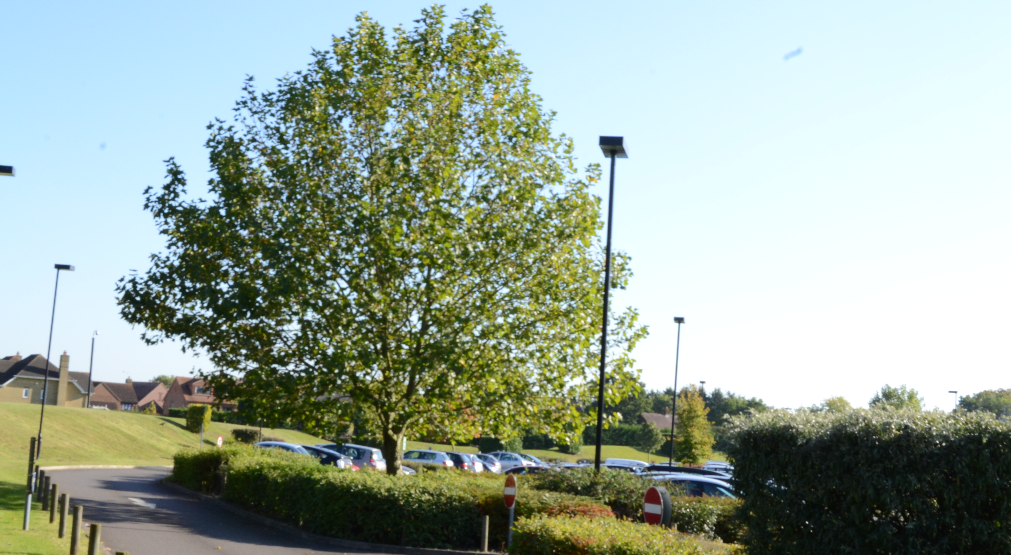
Establishing/ mid shot.
One thing is picture is that it was focused the background didn’t effect the focused on the tree.
There is nothing we disliked about this image.
This picture is a type of
landscape/
Nature genre taking at the
College car park.
BY Nana Jaroniak

Slide 3
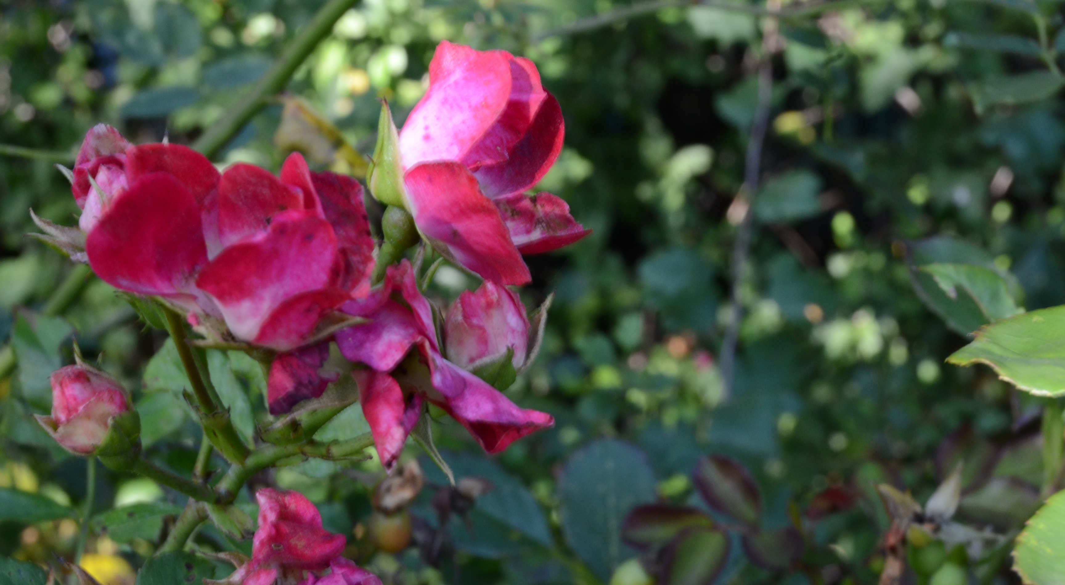
Background
Dislikes
I do not like the bottom of the pant as it is out of focus. Not zoomed to enough
Likes
We like the contest of colours from the green background to the pink flower
This image fits in to the genre of nature as it expresses
the natural colours of an flower and natures coloue’s( green)
I have used the role of third in this image but from the left side as it seems more aesthetics
pleasing
By Jessica Del Vecchio

Slide 4
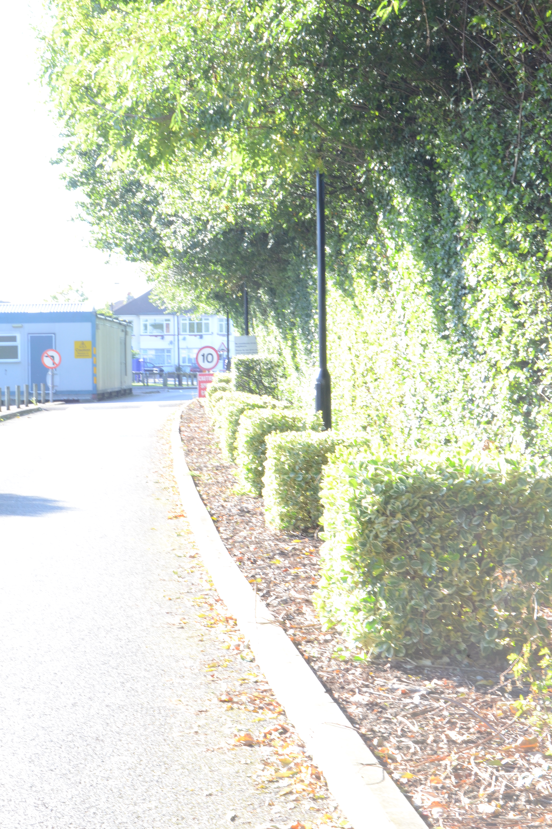
Leading lines
This shot was taken by the car park. We liked the fact that it was straight and angled nicely. We also thought that nothing was out of focus.
We disliked and thought we could improve the brightness, it needs to be colour corrected.
By Lucy Cumming

Slide 5
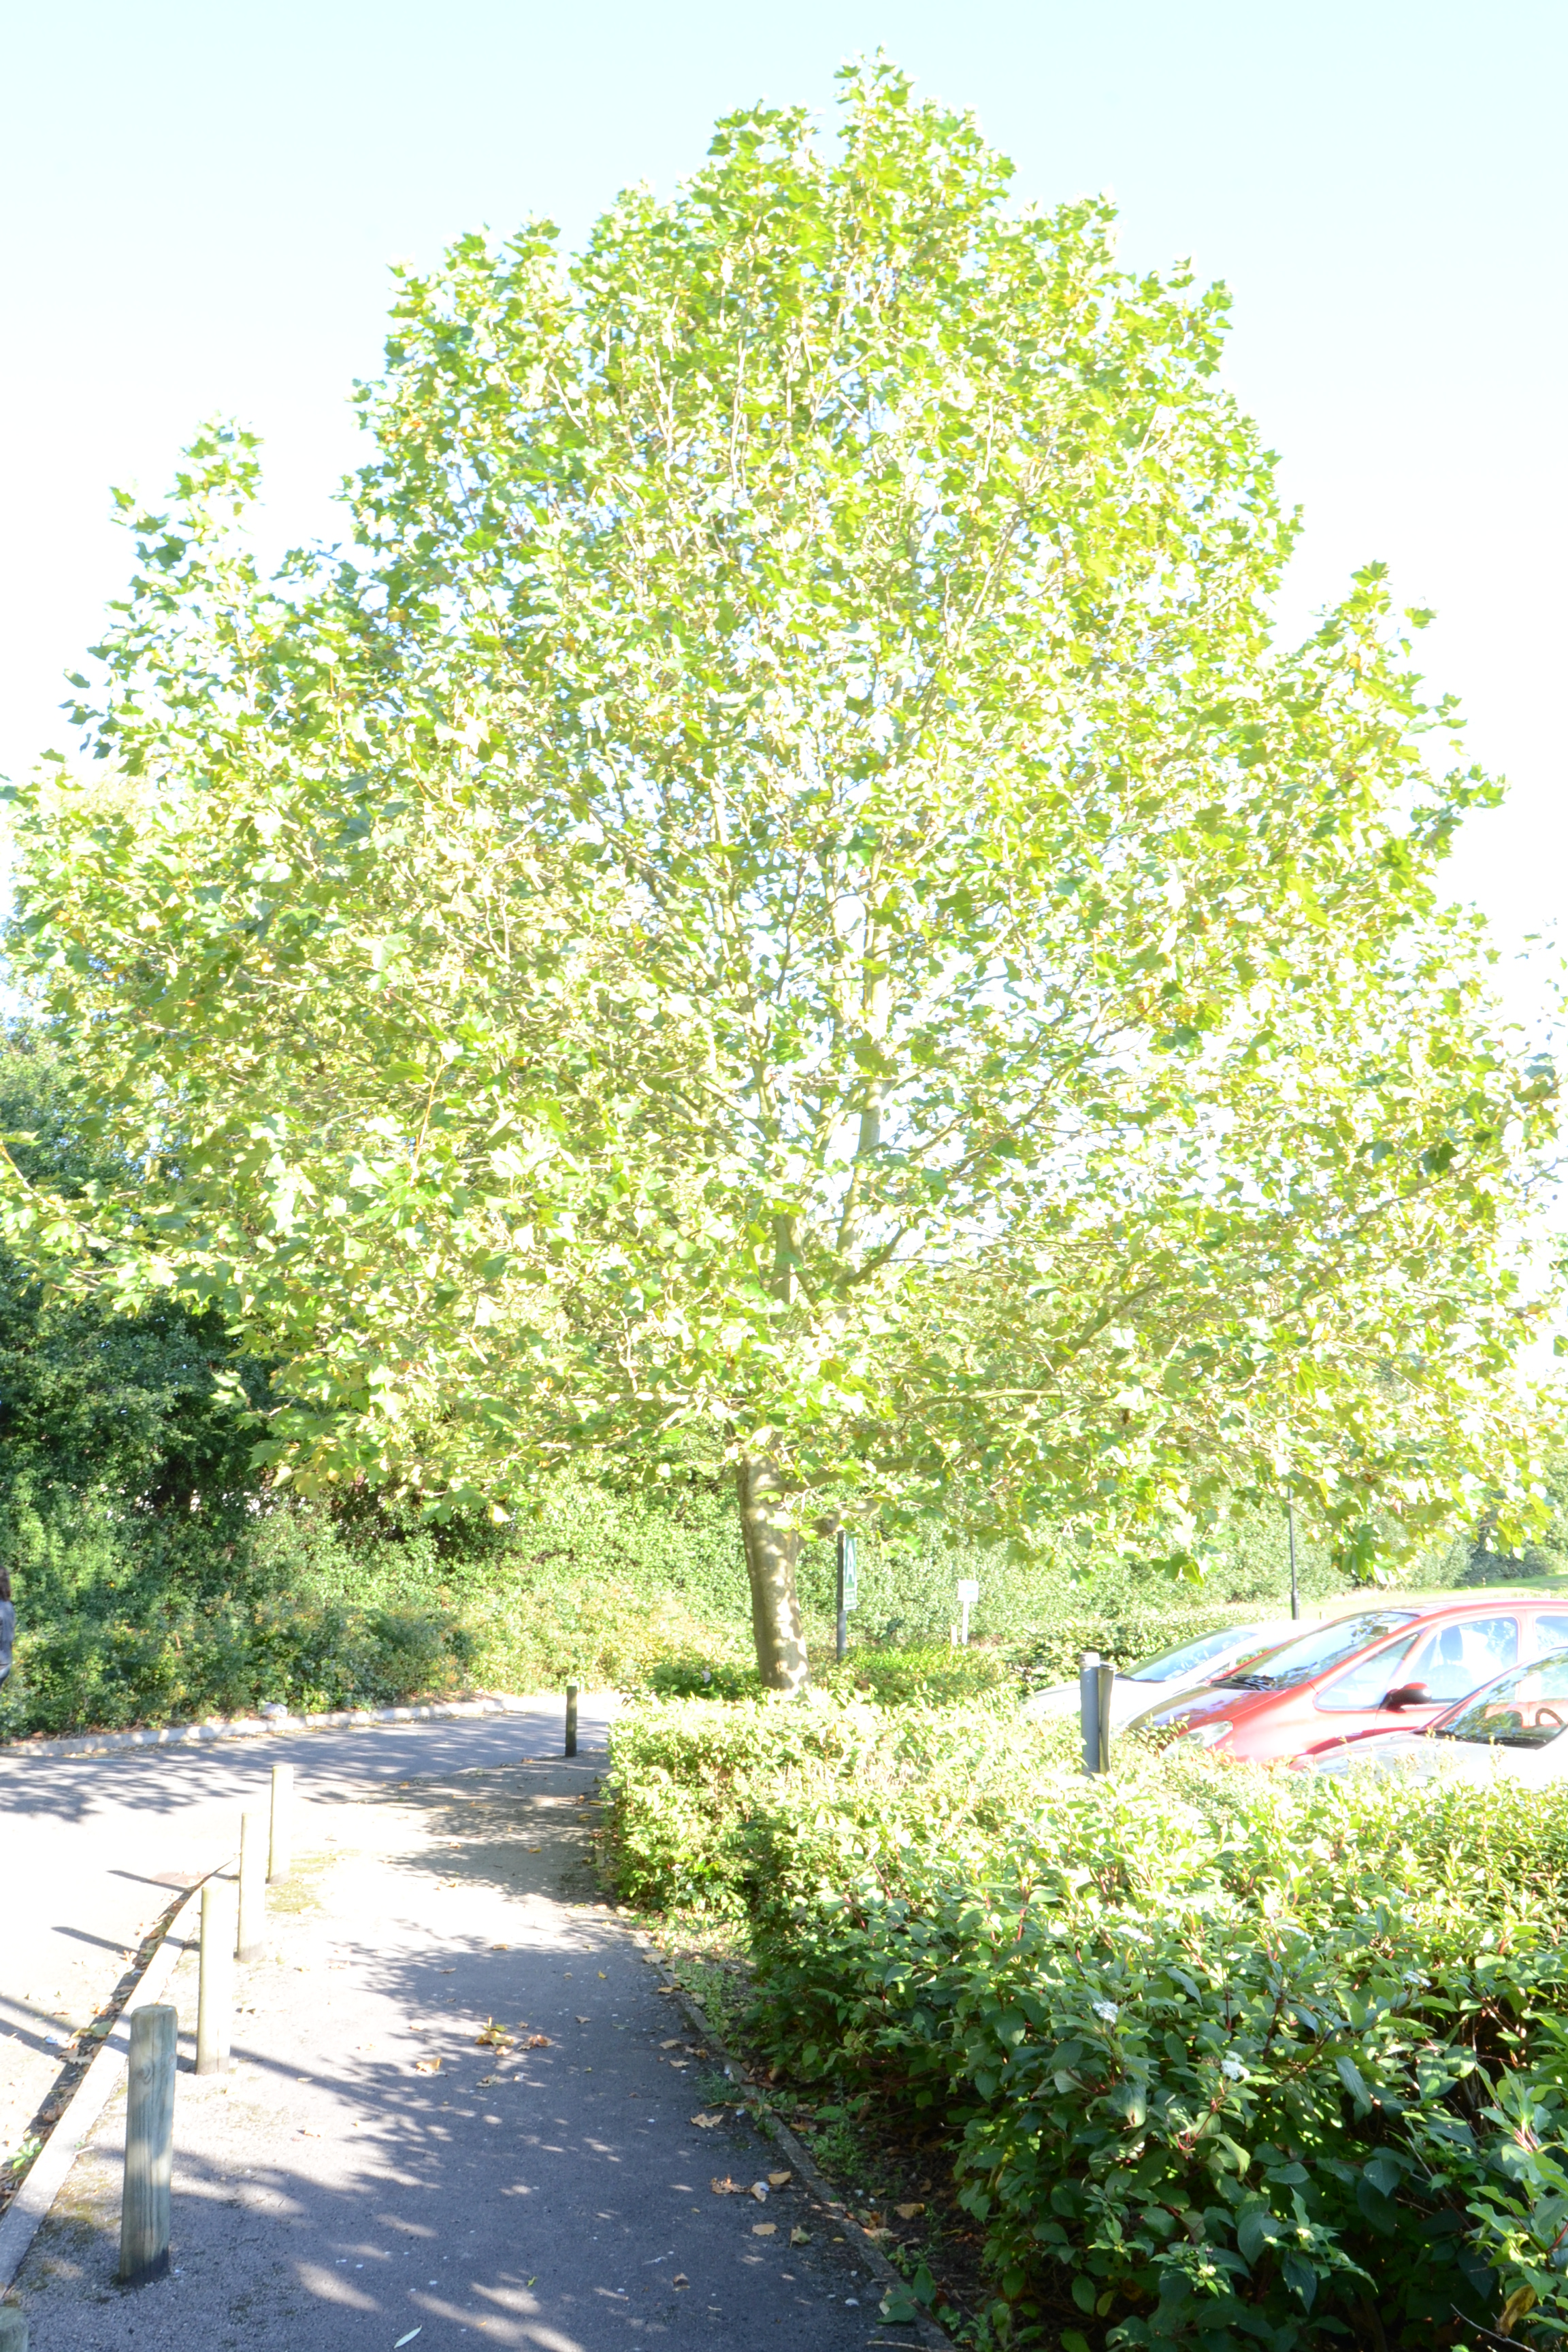
Low angle
By Ellen Rouse-Barron

Slide 6
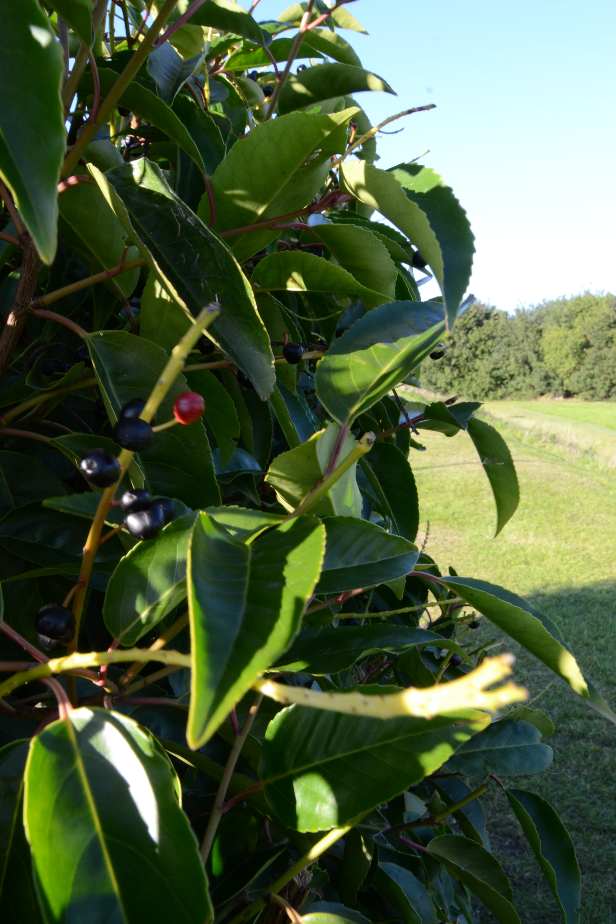
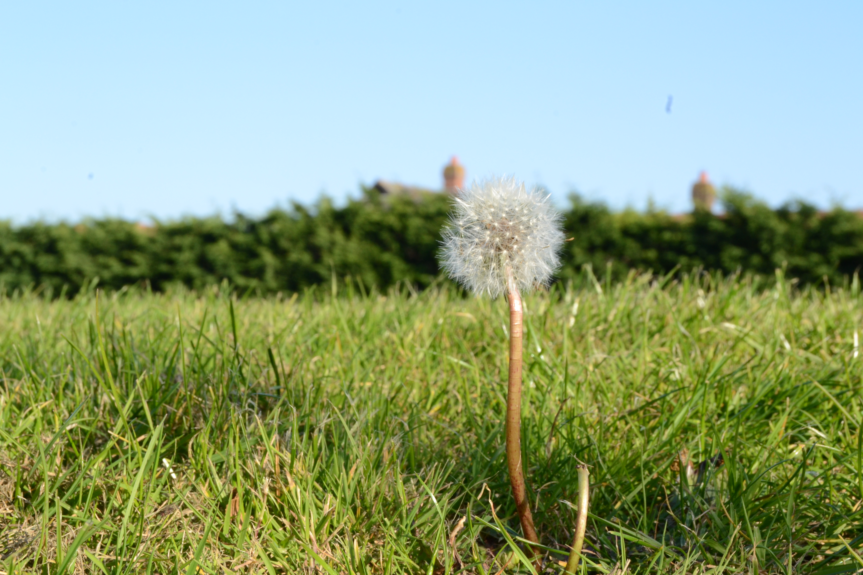
Balanced
By Ellen Rouse-Barron

Slide 7
